Slide 1
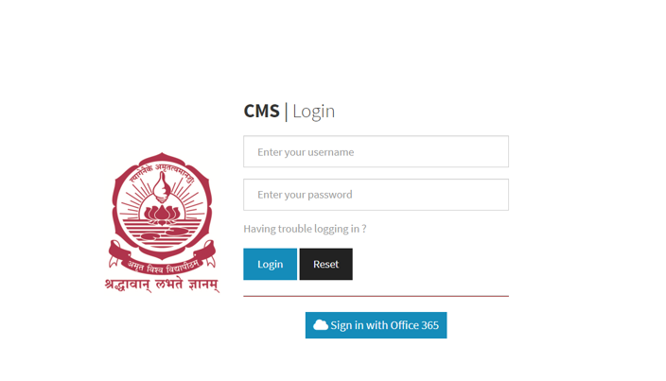

Slide 2
Passess List
Student Name | Roll no | Branch | No.Of Pasess issued in a month | Pass Type Home/Day pass | Room No | Approve/ Reject pass
XXXXXX | CB.EN.************ | YYY | Z | H/D | F-***
A
R

Slide 3
Total No.Of Students In the Hostel/Bhavanam:
No.Of Students Outside the Campus:
No.of students on day pass:
No.of students on home pass:
No.Of Students Inside the Campus:

